Slide 1



IPL 2008-2024 Dashboard
View in Power BI
Last data refresh:
2/20/2026 3:08:18 PM UTC
Downloaded at:
2/20/2026 3:11:20 PM UTC

Slide 2
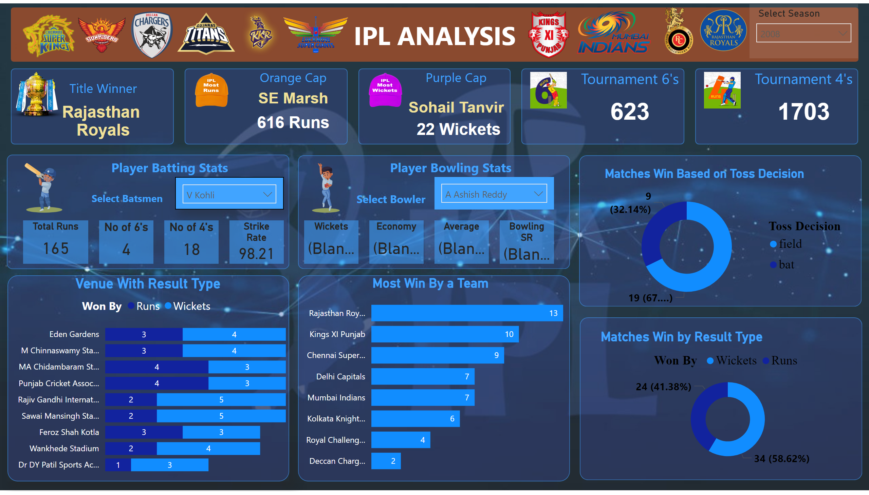
Page 1
Notes:
shape
No alt text provided
slicer
No alt text provided
Title Winner
No alt text provided
shape
No alt text provided
shape
No alt text provided
shape
No alt text provided
shape
No alt text provided
shape
No alt text provided
Orange Cap
No alt text provided
Orange Cap
No alt text provided
Purple Cap
No alt text provided
Purple Cap
No alt text provided
Tournament 6's
No alt text provided
Tournament 4's
No alt text provided
image
No alt text provided
image
No alt text provided
image
No alt text provided
image
No alt text provided
image
No alt text provided
image
No alt text provided
image
No alt text provided
image
No alt text provided
image
No alt text provided
image
No alt text provided
image
No alt text provided
image
No alt text provided
image
No alt text provided
image
No alt text provided
image
No alt text provided
slicer
No alt text provided
shape
No alt text provided
shape
No alt text provided
Total Runs
No alt text provided
No of 6's
No alt text provided
No of 4's
No alt text provided
Strike Rate
No alt text provided
textbox
No alt text provided
image
No alt text provided
Economy
No alt text provided
Average
No alt text provided
Bowling SR
No alt text provided
textbox
No alt text provided
textbox
No alt text provided
image
No alt text provided
slicer
No alt text provided
Wickets
No alt text provided
shape
No alt text provided
Matches Win Based on Toss Decision
No alt text provided
shape
No alt text provided
Matches Win by Result Type
No alt text provided
shape
No alt text provided
Venue With Result Type
No alt text provided
shape
No alt text provided
Most Win By a Team
No alt text provided
textbox
No alt text provided

